Slide 1
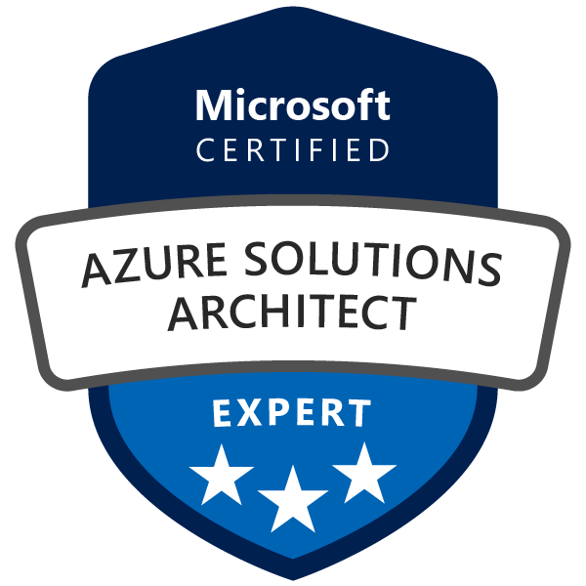
Exam AZ-300: Microsoft Azure Architect Technologies Crash Course
Tim Warner

Slide 2

Tim Warner
Based in Nashville, TN, US
MCT since 1997
MVP since 2017
Twitter: @TechTrainerTim

Slide 3
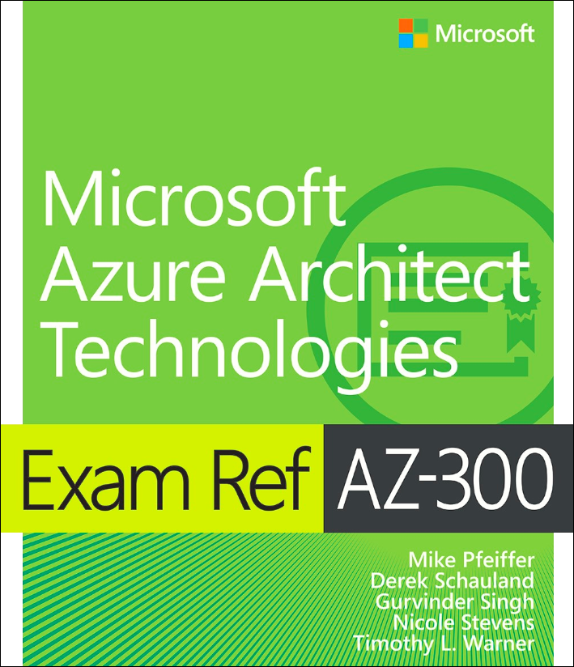
Tim Warner
Available for preorder
25-Nov-2019 pub date
timw.info/ms300
Safari Books Online

Slide 4
Course Materials
timw.info/az300

Slide 5
Day 1 of 2 Agenda
Introduction
Azure storage
Azure IaaS architecture
Virtual machines
Networking
Azure security and governance
Subscription management
RBAC
Azure migration

Slide 6
Day 2 of 2 Agenda
Azure App Service family
Web apps
"Serverless" apps
Containers in Azure
Authentication and data security
MFA
Data encryption
Event/message pipelines
AZ-300 certification strategy

Slide 7
Ground rules
AZ-300 is an expert-level certification
You should already know how to deploy and configure Azure resources
This is a "crash course"
We have six hours, and we'll need every minute
Please ask/answer questions and provide feedback in the Q/A panel, not the group chat

Slide 8
Tim's Certification Study Pyramid
Interdependence
Content knowledge
Practical application
Test-taking skills

Slide 9

Let's get to work!

Slide 10
Module 1: Deploy and Configure Azure Infrastructure

Slide 11
Module 1 Learning Objectives
Analyze resource utilization and consumption
Create and configure storage accounts
Create, configure, and automate deployment of Windows and Linux virtual machines (VMs)
Create connectivity between virtual networks

Slide 12
Module 1 Learning Objectives (Cont’d)
Implement and manage virtual networking
Manage Azure Active Directory (Azure AD)
Implement and Manage Hybrid Identities

Slide 13
Our Environment

Slide 14
Module 2 Implement Azure Workloads and Security

Slide 15
Module 2 Learning Objectives
Migrate servers to Azure
Configure serverless computing
Implement application load balancing

Slide 16
Module 2 Learning Objectives (Cont’d)
Integrate an on-premises network with an Azure virtual network
Manage role-based access control (RBAC)
Implement Multi-Factor Authentication (MFA)

Slide 17
Module 3: Create and Deploy Apps in Azure

Slide 18
Module 3 Learning Objectives
Create web apps by using PaaS
Design and develop apps that run in containers

Slide 19
Module 4: Implement Authentication and Secure Data in Azure

Slide 20
Module 4 Learning Objectives
Implement authentication
Implement secure data solutions

Slide 21
Module 5: Develop for the Cloud and for Azure Storage

Slide 22
Module 5 Learning Objectives
Develop solutions that use Cosmos DB storage
Develop solutions that use a relational database
Configure a message-based integration architecture
Develop for autoscaling

Slide 23
Module 6: Exam AZ-300 Exam Strategy

Slide 24
Module 6 Learning Objectives
Grasp the content
Acquire the hands-on skills
Master computer-based testing
Comprehend what to expect before, during, and after the exam

Slide 25
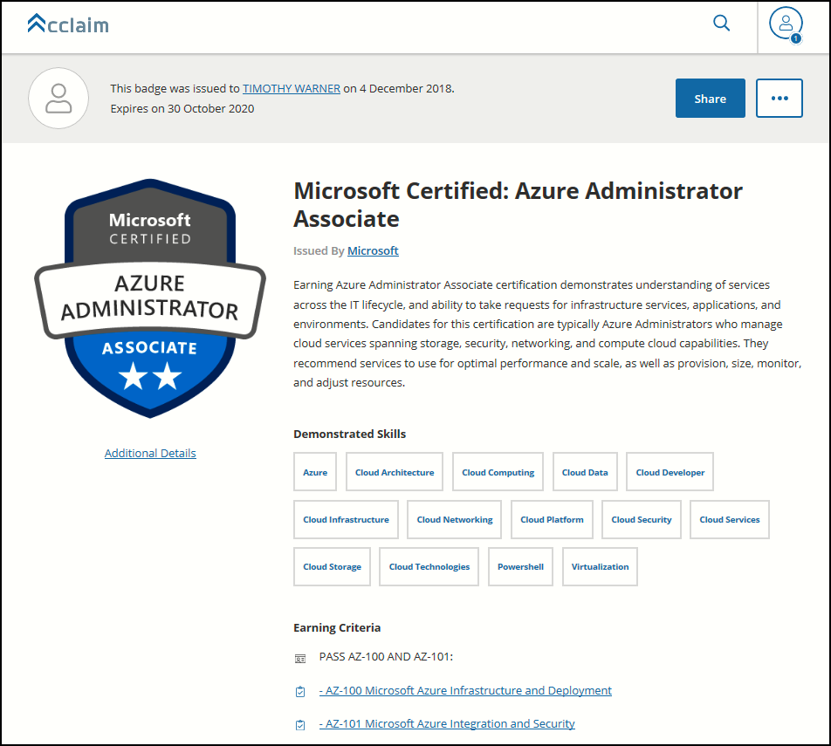
Digital Credentials by Credly/Acclaim

Slide 26
Exam AZ-300 Item Types

Slide 27
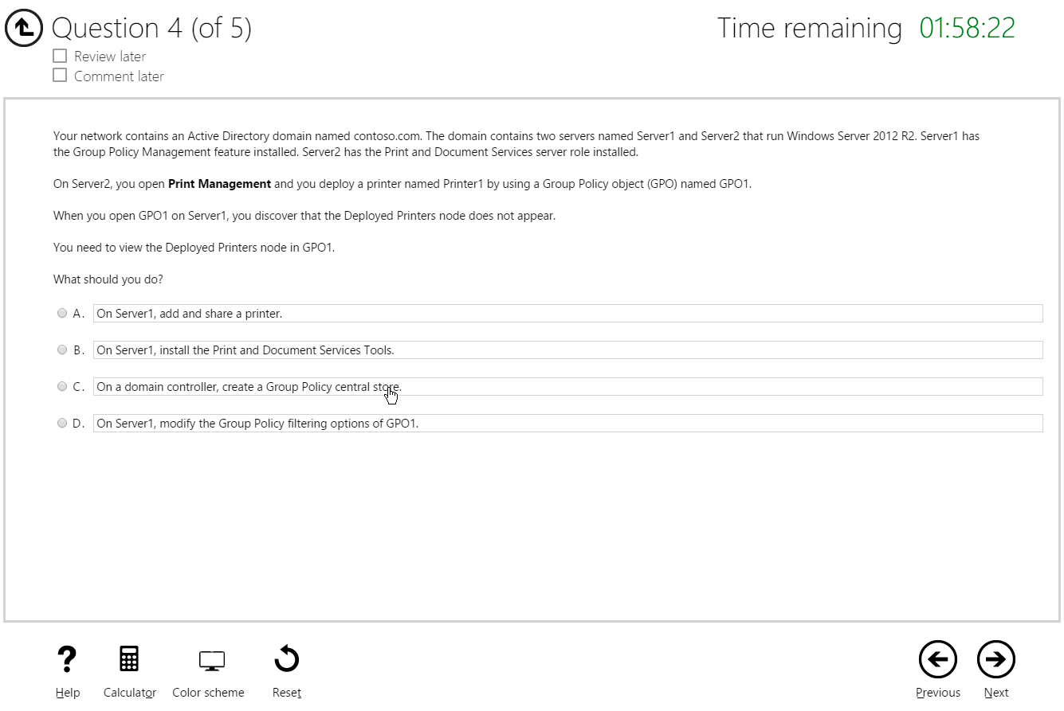
Multiple Choice

Slide 28
Repeated Scenario
You need to move an Azure VM to another hardware host.
Solution: You redeploy the VM.
Does this solution meet the goal?
Yes
No

Slide 29
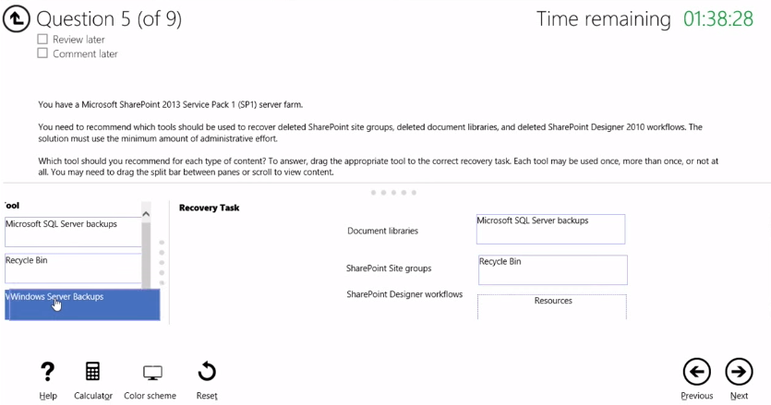
Select and Place

Slide 30
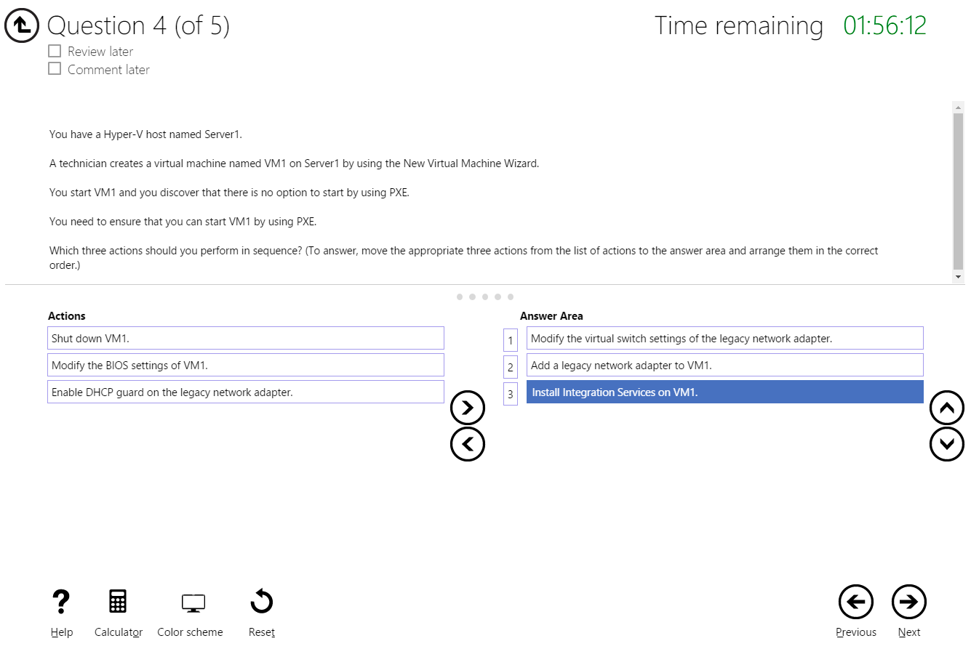
Build List and Reorder

Slide 31
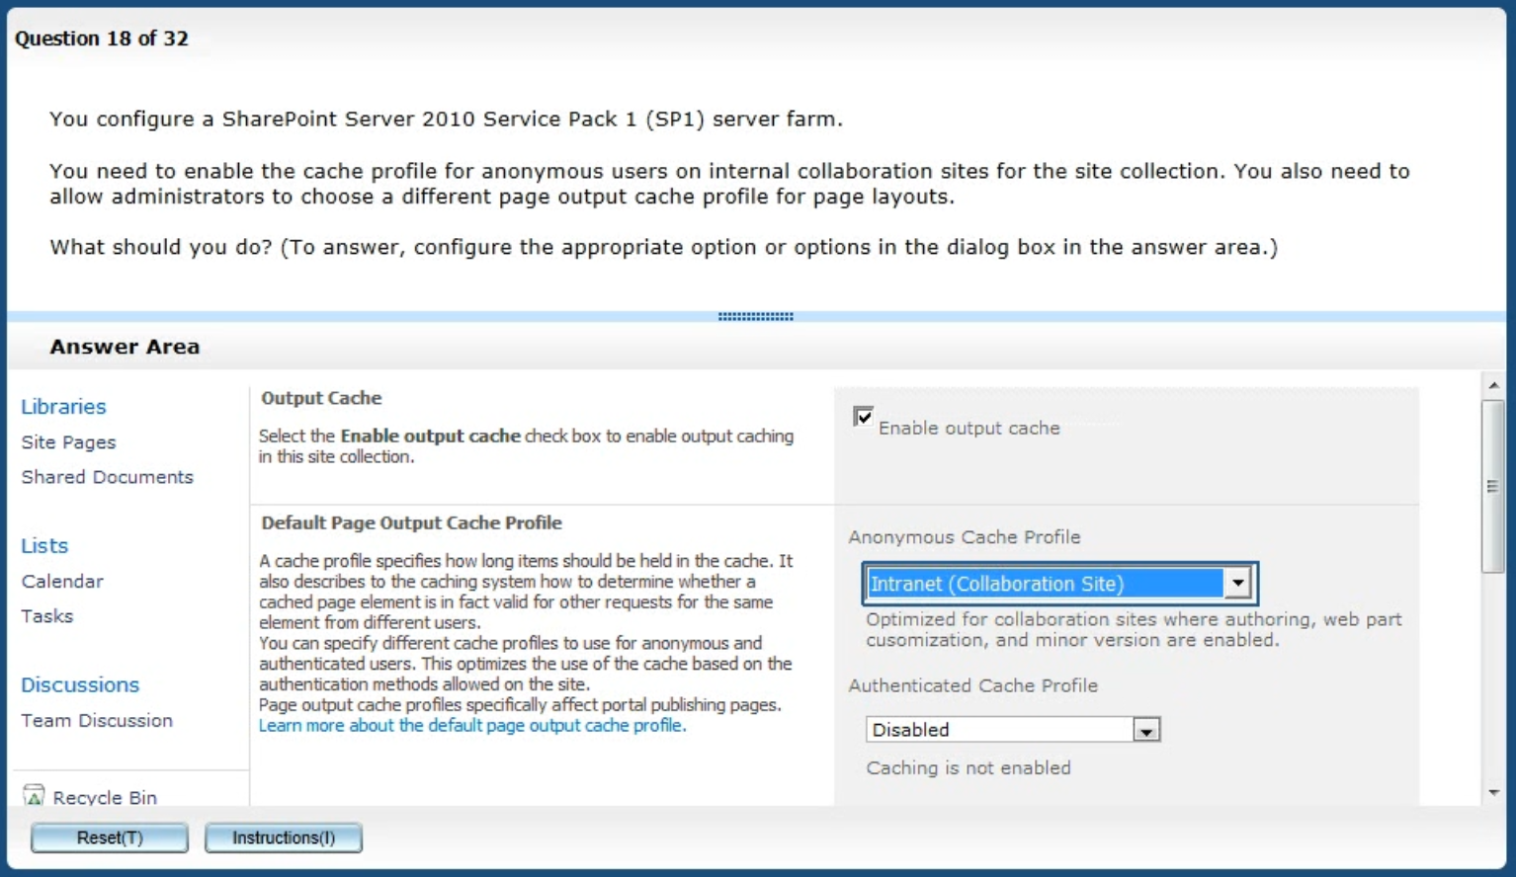
Active Screen/Fill in the Blank

Slide 32
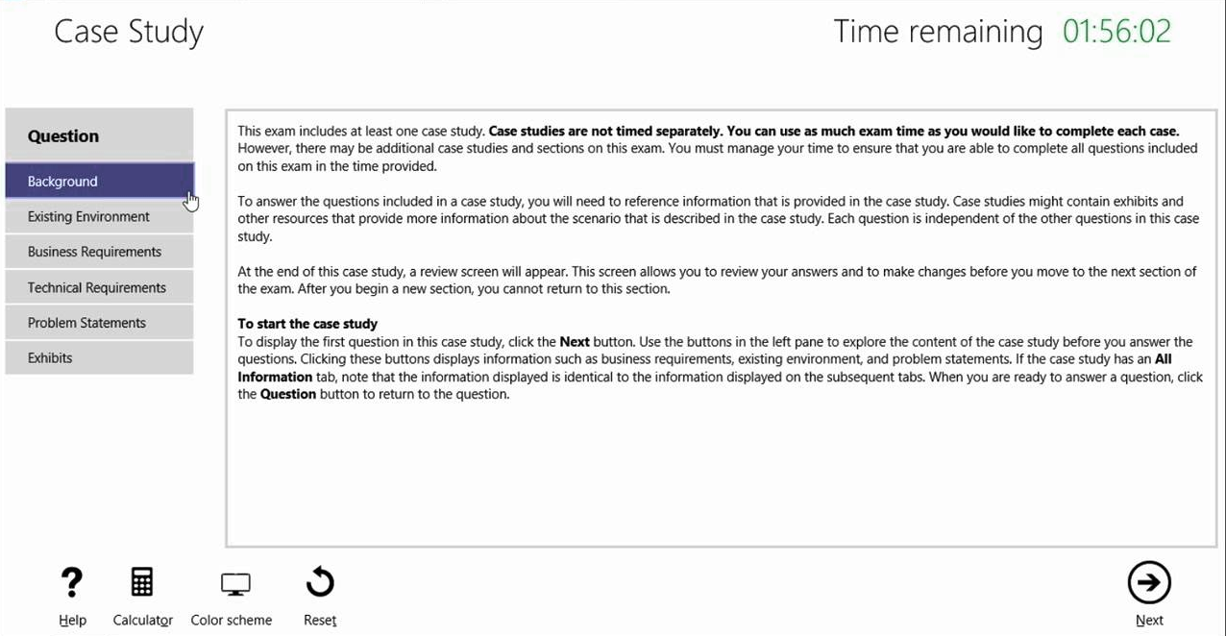
Case Study

Slide 33
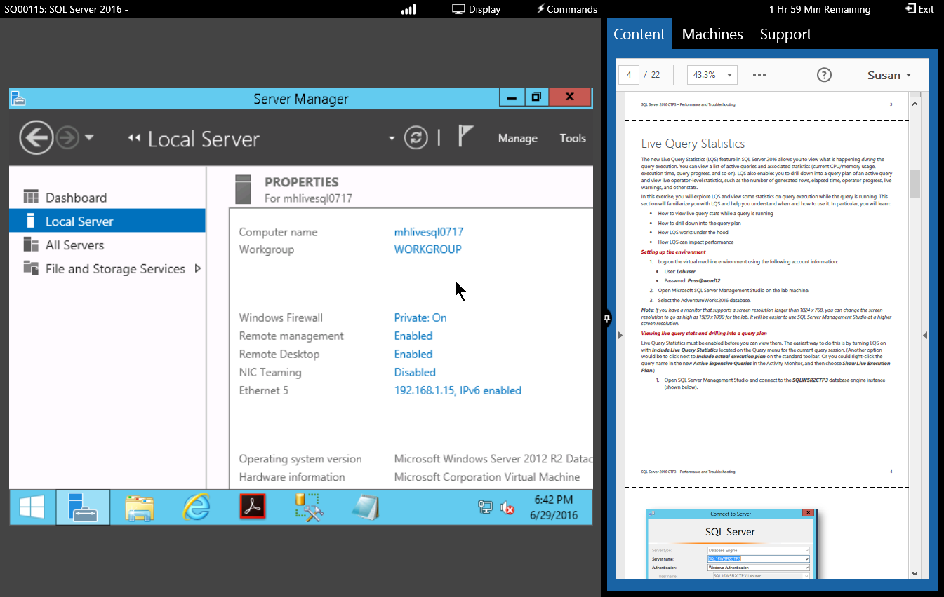
Performance-Based Lab

Slide 34
AZ-300 Exam Strategy/Tips
ARM API suggestion:
70 percent Azure portal
20 percent Azure PowerShell
10 percent Azure CLI
Expect to see lots and lots and lots of JSON
Performance-based labs
Open a second tab for shell.azure.com
Don't be afraid to file an item challenge/grievance

Slide 35
Thank you!
Course materials: timw.info/az300
Twitter: @TechTrainerTim
Work: Pluralsight.com
Web: TechTrainerTim.com

